Slide 1
The Effects of ABV and IBU on Beer Style Demand
Case Study 1
Prepared By:
Joshua Hudson
Notes:
Hello
Today I am going to share some interesting data that studies possible relationships between ABV (Alcohol by Volume) and IBU (International Bitterness Unit), as well as, their possible relationship with styles of beer. And all this with the hopes that Anheuser-Busch could maintain its competitive advantage by capitalizing on some potentially hidden demands, nationwide.

Slide 2
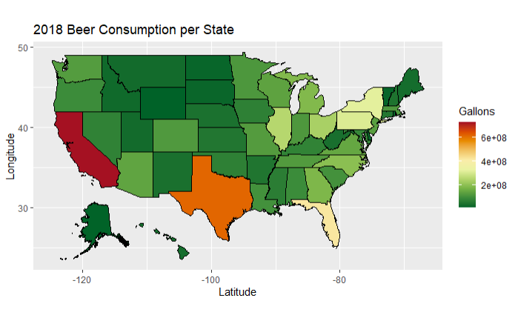
American Beer Consumption
2018 data from online VinePair article published in 2020: https://vinepair.com/articles/map-states-drink-beer-america
Notes:
How well is Anheuser-Busch positioned to support America’s beer consumption? The following are the locations for all 13 AB breweries
Stars are the AB breweries
1 – Fairfield, California
2 – Los Angeles, California
3 – Fort Collins, Colorado
4 – Houston, Texas
5 – St. Louis, Missouri
6 – Cartersville, Georgia
7 – Columbus, Ohio
8 – Tampa, Florida
9 – Jacksonville, Florida
10 – Williamsburg, Virginia
11 – Baldwinsville, New York
12 – Newark, New Jersey
13 – Merrimack, New Hampshire

Slide 3
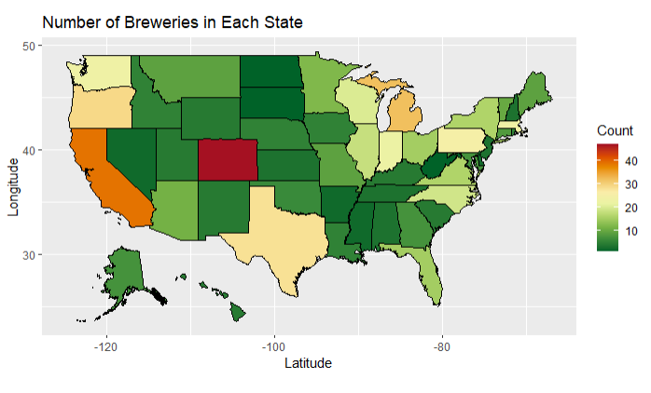
American Brewery Distribution
Notes:
This map shows how all American beer breweries are distributed.
With Stars are the AB breweries
1 – Fairfield, California
2 – Los Angeles, California
3 – Fort Collins, Colorado
4 – Houston, Texas
5 – St. Louis, Missouri
6 – Cartersville, Georgia
7 – Columbus, Ohio
8 – Tampa, Florida
9 – Jacksonville, Florida
10 – Williamsburg, Virginia
11 – Baldwinsville, New York
12 – Newark, New Jersey
13 – Merrimack, New Hampshire

Slide 4
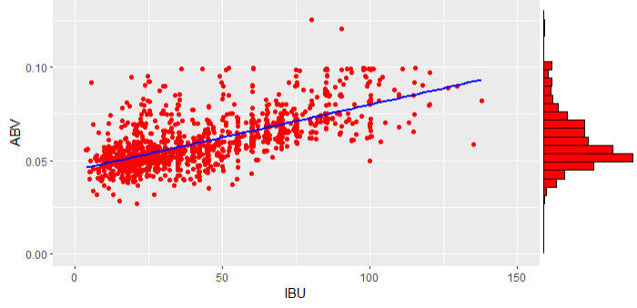
IBU vs ABV
ABV Value Summary Statistics
Min = 0.027 1st Quartile = 0.050
Mean = 0.06 Median = 0.057
Max = 0.125 3rd Quartile = 0.068
Spearman Test for Correlation:
Alpha = 0.05
P-value = 2.2e-16
Correlation Coefficient = 0.6707224
Notes:
Conducted a statistical test to determine if there is a relationship between IBU and ABV. Based on the results of this test, there is evidence that IBU and ABV are significantly correlated.

Slide 5
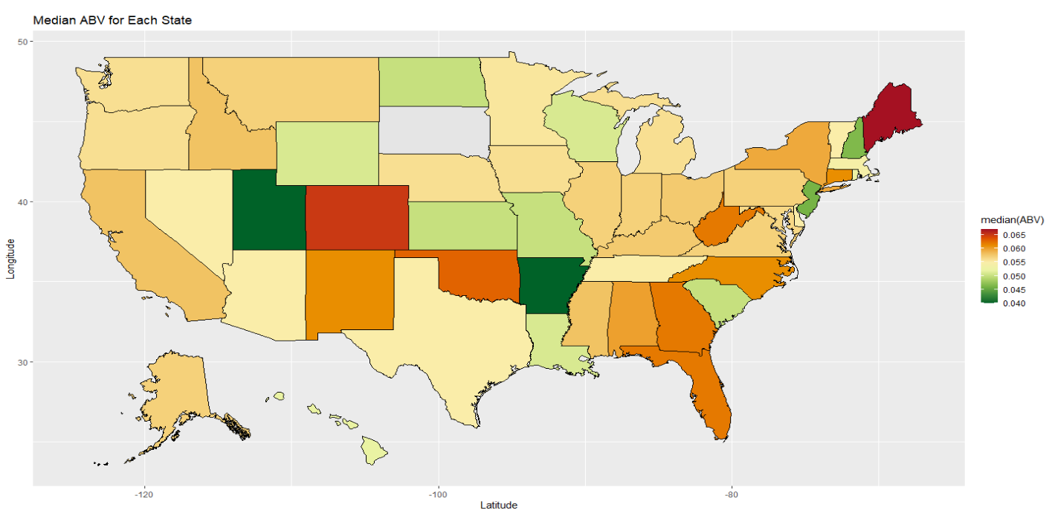
Median ABV for Each State
Maine had the highest median ABV in the USA ~ 6.7%
West Virginia, Georgia, and Florida high median ABV values.
Brewery with the max ABV beer was in KY ~ 12.5%
Notes:
We wanted look at the map from a different perspective. Namely, see which states/regions had the highest median ABV (Alcohol By Volume). Maine had the highest MEDIAN at 6.7%. Whereas, Kentucky had the highest Maximum 12.5%

Slide 6
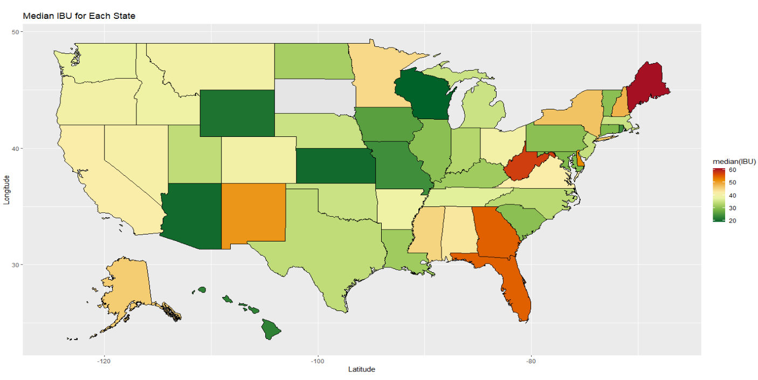
Median IBU for Each State
Maine had the highest IBU median in the USA ~ 61
West Virginia, Georgia, and Florida high median IBU values.
Notes:
As you can see some of the heavy hitters on the ABV map followed over to the IBU map. This helps to show the possible correlation between IBU and ABV, that we previously discussed.

Slide 7
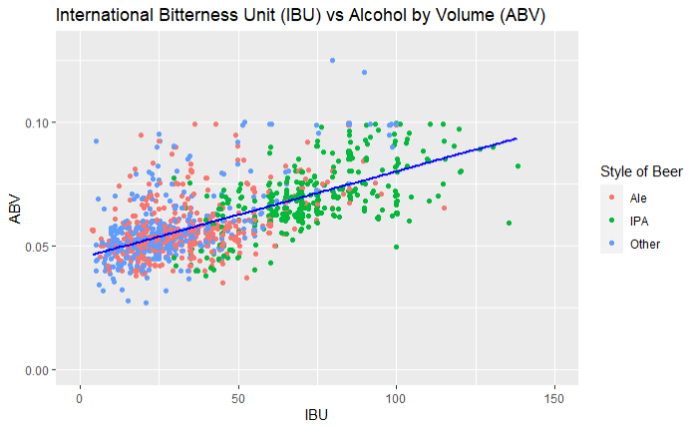
IBU vs ABV
Notes:
So, lets drill down a little further to see how ABV and IBU relates to different types of beer. As you can see, IPAs typically have higher IBU and ABV, followed closely by all the other types of Ales. Whereas, lagers/pilsners/ciders that make up the “other” category appear to have lower IBU and ABV. Two sample t-testing confirms that the average IBU and ABV values for Ales and IPAs are significantly different.
With this in mind, here is how Anheuser-Busch's beers fall along this spectrum (animation). The Majority of AB’s beers are lagers. That is, most of them fall into the blue (“other”) category. This may be something to make note of, that there could be an under tapped market in the IPA and other Ales industry for AB to consider pursuing to maintain a high competitive advantage.
So to condense this down, What this data shows us is that:
As IBU increases, ABV appears to increase and as
Different styles of beer appear to cluster at different stages of this linear relationship.
So what can we do with this information? We can use it to help predict where in America each AB beer is in most demand based on style and ABV/IBU values!!! One way we can make these predictions is with machine learning. Namely K- Nearest Neighbors or KNN. How KNN works is fairly intuitive, in that you feed the model a states median ABV value and median IBU value and it has been trained to take these values and assign them a style of beer. It does this by looking at the coordinate’s 5 nearest neighbors in the model and classifying the states most in-demand beer as either IPA, Ale, or other. For example, Maine’s median ABV is 0.067 and median IBU value is 61.

Slide 8
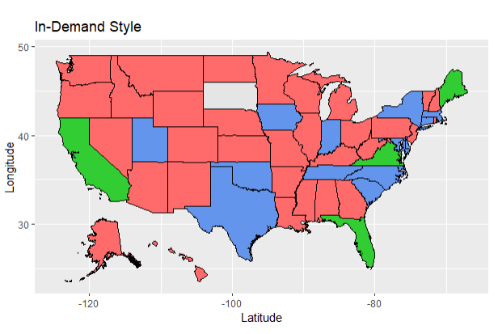

Where is the Demand?
Notes:
Using machine learning model, (KNN), we can predict which style of beer is in most demand for each state. Couple this with the consumption rate data, there could be opportunity to capitalize on understanding both sets of demand.

Slide 9
Conclusion
American Beer Consumption
American Brewery Location
Study Beer Attributes
ABV vs IBU
ABV vs IBU Mapping
Study Beer Categories
IPA vs Ales vs Other
Competitive Advantage Mapping

